Slide 1
House Price Prediction
Predict the price of homes at sale for the
Ames, Iowa Housing dataset
Zi Xin Lee, Dylan Ng,, Jeriel Wong, Rachel Lim DSI 16 - Project 2
Aug 2020

Slide 2
Agenda
Defining the context and scope
EDA
Feature Engineering
Modelling
Conclusion
Limitations

Slide 3
Context
Develop a regression model that will make accurate predictions of house prices in the city of Ames in Iowa, USA.
Homeowners can have a better gauge of a fair selling price they should list for their house. This way, they will not underprice their house and lose out on potential profit.
Homebuyers can know what is a fair price to be paying for a particular house and will not unknowingly purchase overvalued properties.

Slide 4
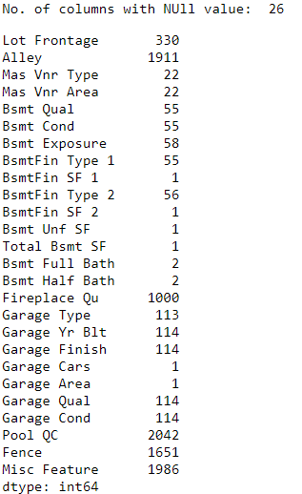
Data Set
2051 past sales records from 2006 to 2010 (for training and validation)
849 new data for prediction (test data)
81 columns
Location of the house
Functionality of house
Condition & Quality of house
Area of the house
Materials and their qualities
Features of house and their condition
Sale records details
42 Categorical data 39 Numerical Data
26 columns with NULL (missing) value
“NA” or “none” for categorical features
0 for numerical features
Neighbourhood median for Lot Frontage

Slide 5
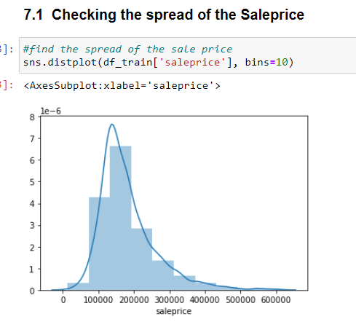
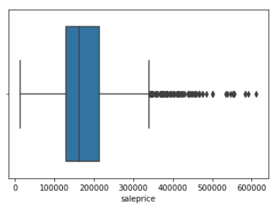
EDA

Slide 6
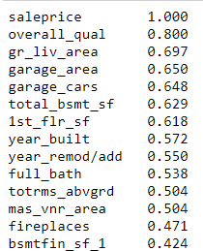
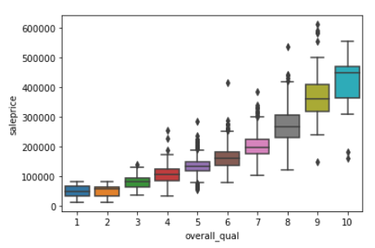
Influence of Factors to Sale Price

Slide 7
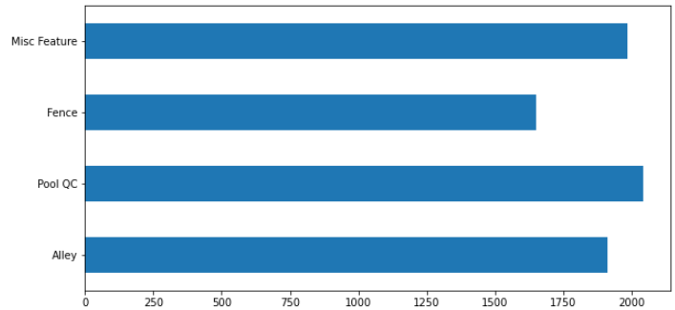
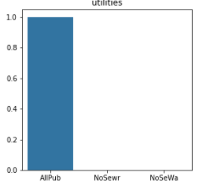
EDA
Removal
80% missing values
Remove features without meaningful information
low variance in their values (90% of the observations is one value E.g. Utilities
High correlation features ( > 0.86 ) e.g Fireplace

Slide 8
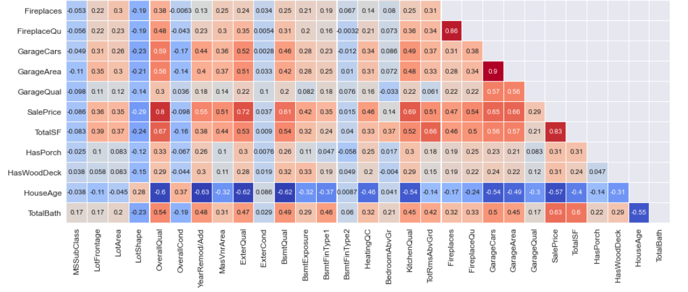
Check for multicollinearity
Dropped
Dropped

Slide 9
EDA
Data preprocessing
Integer encoding for ordinal variables, which involves mapping each unique label to an integer value
Changing numerical type values to string category (if the feature is nominal) = MS Sub Class
One-hot encoding of nominal variables
Log transformation of the target variable SalePrice to reduce its scale of values. This makes the model less sensitive to outliers because a log transformation de-emphasises them (outliers are brought close in). This would in turn improve prediction accuracy.

Slide 10
Feature Engineering
Consolidation of existing variables:
GrLivArea, 1stFlrSF, 2ndFlrSF, TotalBsmtSF, BsmtFinSF1, BsmtFinSF2 and BsmtUnfSF,consolidated as one feature TotalSF aka Total square footage
TotalBath: Total number of full and half bathrooms in the house. Replaced HalfBath, BsmtHalfBath, FullBath, BsmtFullBath
HouseAge: YrSold - YearBuilt
Convert columns into binary variables to indicate the presence or absence of certain features:
HasPorch: Grouped together OpenPorchSF, EnclosedPorch, 3SsnPorch, ScreenPorch
HasWoodDeck: Converted from WoodDeckSF
At the end of the process, 39 columns were left prior to one-hot encoding, and after one-hot encoding, the total number of feature columns was 169.

Slide 11
Modeling
Run the 3 regularised linear models (Lasso, Ridge, and Elastic Net) with all 169 features
Linear regression was not used as a large number of features would result in severe overfitting.
Elastic Net performed the best in the initial modelling step
Continue using Elastic Net during feature selection phase
Elastic Net removed 74 out of 169 features –> 75 remaining
Reduce predictors to 25 via two methods:
Select 25 predictors from initial E-Net regression based on magnitude of coefficient
Recursive Feature Engineering
Evaluate the two sets of 25 predictors using Elastic Net and select the set with better performance
Predictors obtained from RFE performed better –> selected as final set of predictors
Evaluate the performance of an OLS linear regression model using finalised predictors –> LR did not perform better than Elastic Net –> Elastic Net is selected as the final production model.
Make sale price predictions using test dataset
2 out of the 25 finalised features were not present in test dataset –> predictors reduced to 23
Train Elastic Net model with 23 features –> make sale price predictions. (Kaggle score: 23,406.77)

Slide 12
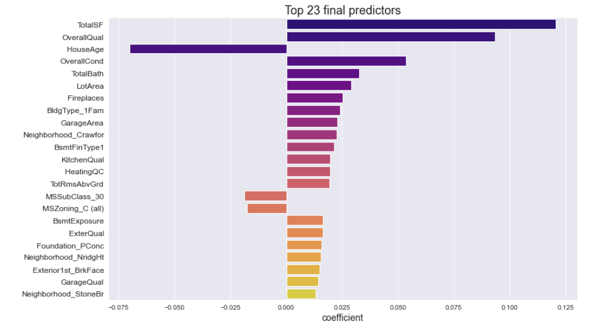
Conclusion

Slide 13
Interpretation of final selected features
Generally higher/better value in predictors like area, number of rooms and quality will have positive impact on house value
House Age and commercial buildings (MS Zoning - Commercial Buildings) will have an inverse impact
Neighborhood-wise, houses located in Crawfor, NridgHt and StoneBr are expected to fetch higher prices. Investing in any undervalued houses in these neighborhoods will likely generate a positive return on investment.
According to this model, BldgType_1Fam aka single-family detached houses and houses with houses with concrete (PConc) foundation will fetch higher prices than other types. However it is inconclusive that these features will definitely fetch higher sale price since most of our data are of these categories.

Slide 14
Limitations
Hyperparameter tuning: A predefined range of values was passed in to tune the hyperparameters for our regularisation models. There is a possibility that there are values outside of the predefined range that could have produced better results.
Other external factors not taken into account: The value of a house is not purely determined by the features we have analysed. There are many other factors which could affect house demand and supply, such as the current economic climate, housing policies, demographic changes, proximity of the house to amenities like malls and schools, and so on. Predictions from our model are limited in its accuracy as it does not consider these factors.
Limited timeframe: Our data comprised only transactions between 2006–2010. This is a pretty short timeframe, which makes it hard to capture actual general trends in sale prices of houses in Ames. The housing market within the 2006-2010 timeframe could be very different from how it is in present time.
Missing values: There were numerous missing values for which we did a convenient imputation for. This has definitely introduced a certain level of inaccuracy into our analysis.
Limited generalisability to houses outside of Ames, Iowa: The predictive model we've built only applies to the houses in Ames and will not be accurate when applied to houses in other cities or countries. To make it more applicable across the board, we could perhaps remove features specific to houses in the U.S. or Ames, such as replacing Ames' neighborhood with a metric describing a property's distance from the city centre, or whether a property is near a buzzing commercial hub, etc.

